Slide 1
Couture AI: Clothing Image Generator Using Stable Diffusion pipeline
AI-powered Fashion Image generation
TEAM NAME:VISION VENTURE
TEAM MEMBERS:
G.Mounika
G.Lavanya
N.Malavika
Y.Meghana Reddy

Slide 2
What is Counter AI? "Counter AI" generally refers to artificial intelligence systems or techniques designed to counteract, defend against, or oppose other AI systems or harmful AI-generated content
Overview of AI-based clothing image generation
AI-based clothing image generation refers to the use of artificial intelligence, particularly deep learning models, to generate realistic clothing images from text descriptions, sketches, or other input data.
Importance of AI in fashion design and retail
AI is becoming increasingly important in both fashion design and retail, offering numerous benefits that transform the way the industry operates
1. Enhanced Design Process
2. Personalization and Customization
3. Optimized Supply Chain Management
4. Improving Sustainability in Fashion
5. Enhanced Customer Experience

Slide 3
In the dynamic fashion industry, the demand for personalized and visually appealing clothing items is ever-increasing. Traditional online shopping platforms often lack the ability to offer customized visual representations of user-defined clothing styles, limiting the shopper's experience and satisfaction. Couture AI aims to solve this problem by integrating Diffusers' Stable Diffusion Pipeline with a user friendly Stream lit interface, allowing users to generate realistic images of clothing based on their descriptions. This project empowers consumers to visualize their unique clothing ideas, enhancing the shopping experience and bridging the gap between imagination and reality in fashion design
Problem Statement
Need for AI-driven automation in fashion
AI-driven automation in fashion is increasingly becoming essential due to the industry's growing complexity, fast-paced nature, and demands for innovation, efficiency, and sustainability

Slide 4
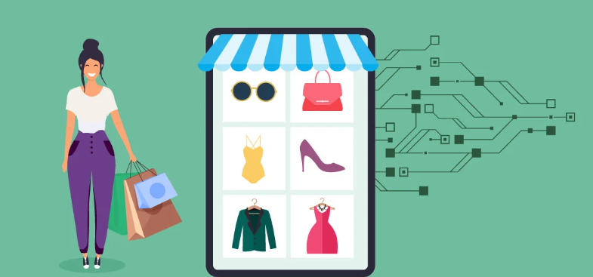
What is Stable Diffusion? Stable Diffusion is a powerful and advanced text-to-image generation model developed by Stability AI and other collaborators. It uses a diffusion process to create high-quality images based on textual descriptions, which can range from simple phrases to more detailed prompts. The model is part of a broader trend in AI-driven creative tools that can generate realistic visuals
Stable Diffusion is a state-of-the-art AI model for image generation that allows users to create high-quality, realistic images from textual descriptions Developed by Stability AI, Comp Vis, and other collaborators, it has quickly become one of the most popular tools for generating images, as it combines powerful machine learning techniques with user-friendly accessibility.

Slide 5
Features of Counter AI
Adversarial Attack Detection
Deep fake and AI Content Detection
Bias Detection and Mitigation
Fraud Prevention
AI Explain ability and Transparency
Input: Text or reference image of clothing
When using AI-driven systems like Stable Diffusion for fashion design, you can provide text prompts or reference images as input to generate clothing designs or images related to fashion.
Text Input (Prompt-Based):
What it is: You provide a written description of the clothing or fashion item you want to generate. The AI interprets the text and produces an image that reflects the details of your description.
How it works: The AI uses its trained model to translate the words into visual elements like colors, fabrics, textures, patterns, and styles, producing a new image based on the prompt.

Slide 6
Advantages of AI-Generated Clothing
1. Faster Design ProcessQuick Prototyping: AI tools can instantly generate multiple clothing designs based on a brief description or reference image. This allows designers to quickly explore a wide range of styles, colors, and patterns, drastically reducing the time needed for the conceptual design phase.
2. Cost Efficiency Reduced Material Costs: AI can help designers visualize multiple clothing options without needing to physically produce each item, which cuts down on fabric waste and prototype creation costs.
3. Customization and Personalization Tailored Designs: AI can generate clothing that caters to individual preferences, including size, style, and fabric choices, allowing for highly personalized garments. This could be applied to custom fashion lines or even mass-market brands offering personalized designs.
4. Exploration of New Styles Innovative Designs: AI can help break traditional design boundaries by generating unique and unconventional clothing styles that might not have been conceived by human designers. This can lead to the emergence of new trends and creative possibilities.

Slide 7
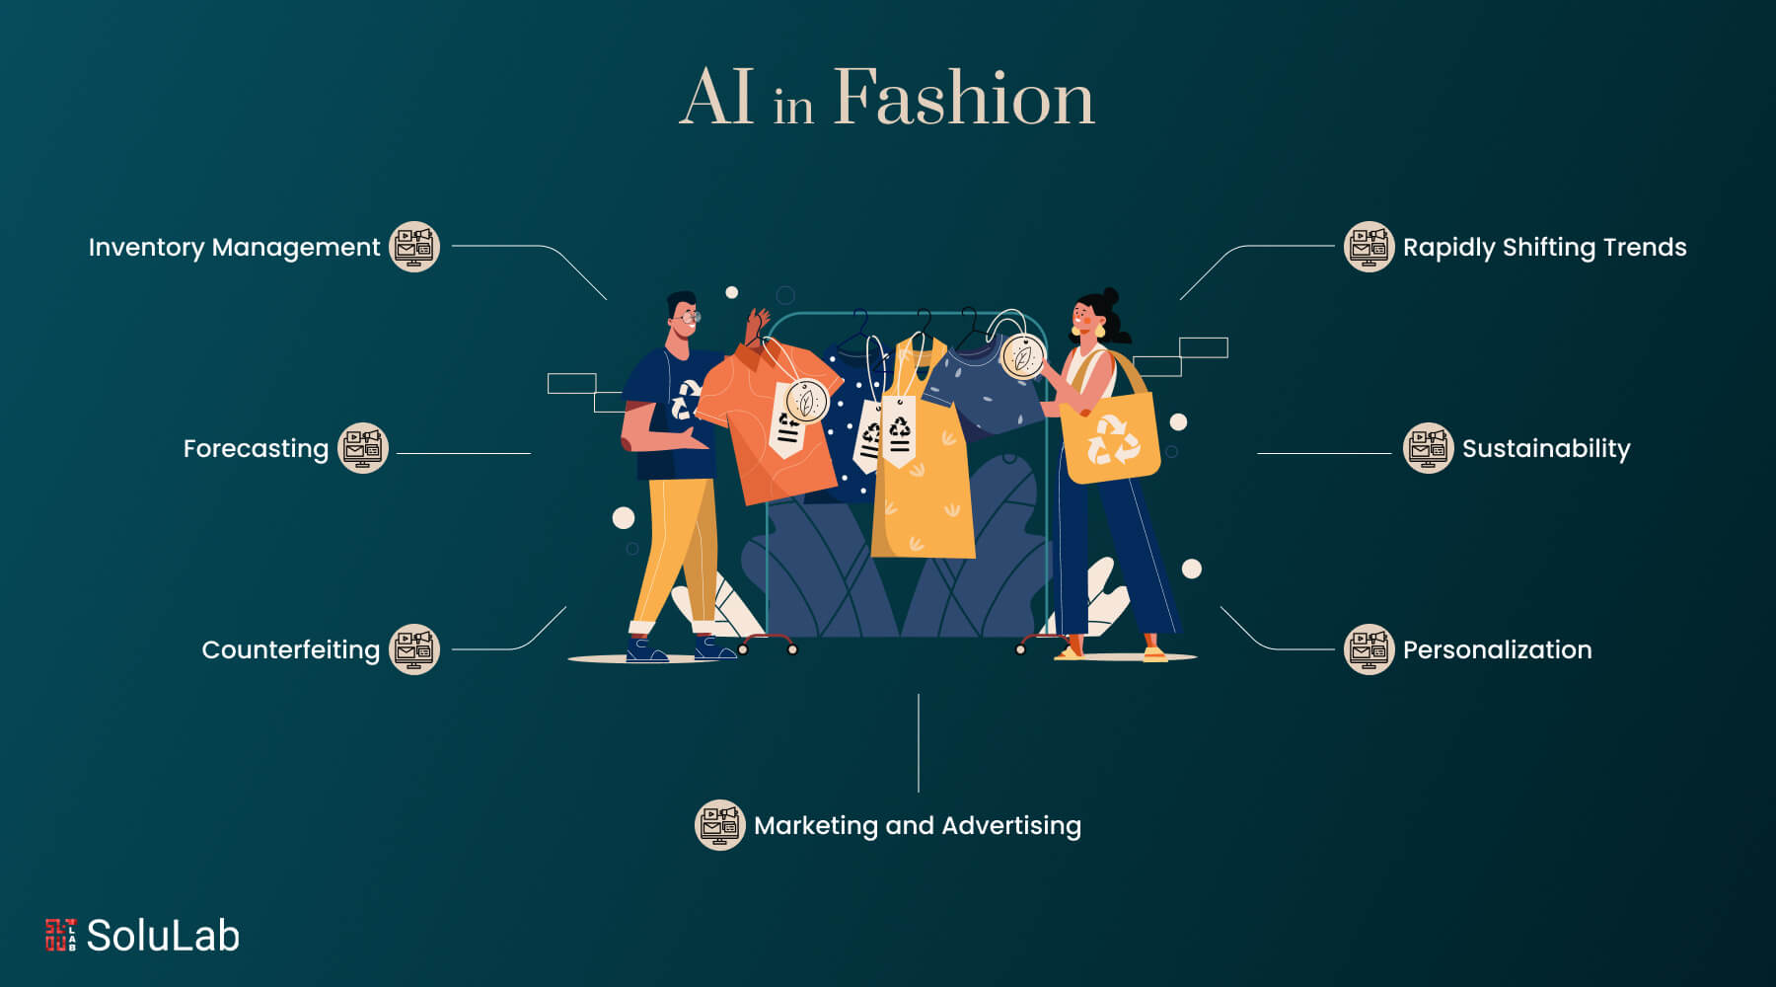
CONCLUSION
In conclusion, AI-generated clothing represents a transformative shift in the fashion industry, offering a wide range of benefits that extend across design, production, sustainability, and consumer experience. By enabling faster design processes, cost efficiency, and personalization, AI empowers designers to create innovative and tailored clothing while reducing waste and overproduction. The ability to generate diverse styles, predict trends, and integrate with emerging technologies like virtual and augmented reality further enhances its value.

Slide 8
THANK YOU

